Slide 1
PHOTOGRAPH PROTOCOL
A GUIDE FOR CLINICAL STAFF

Slide 2
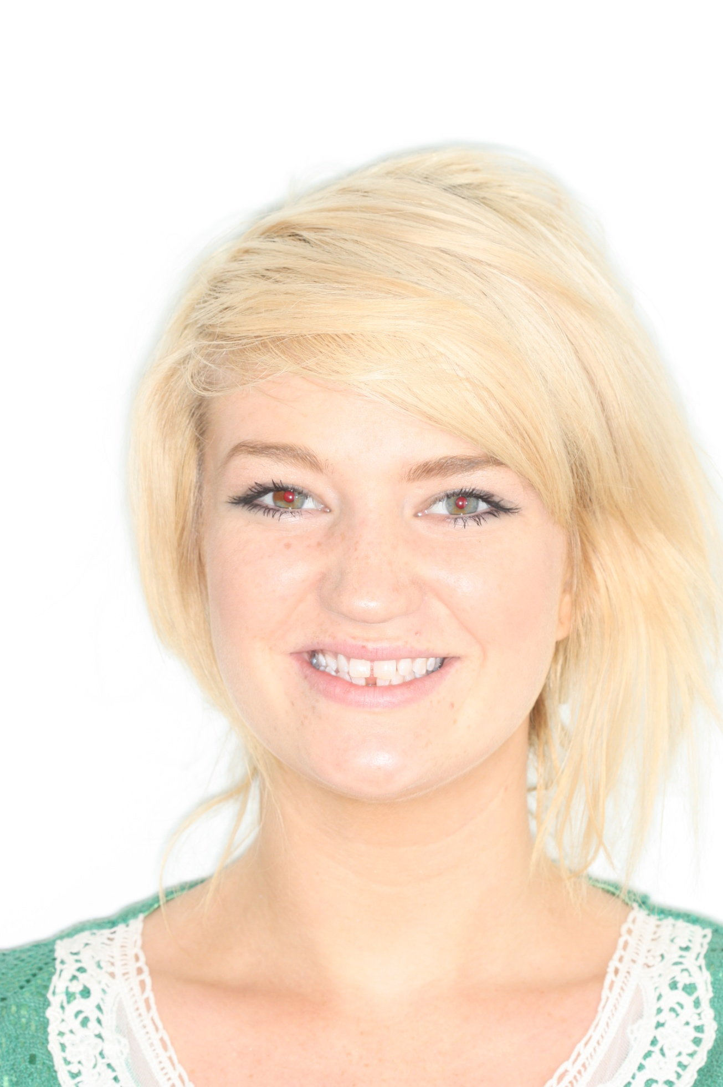
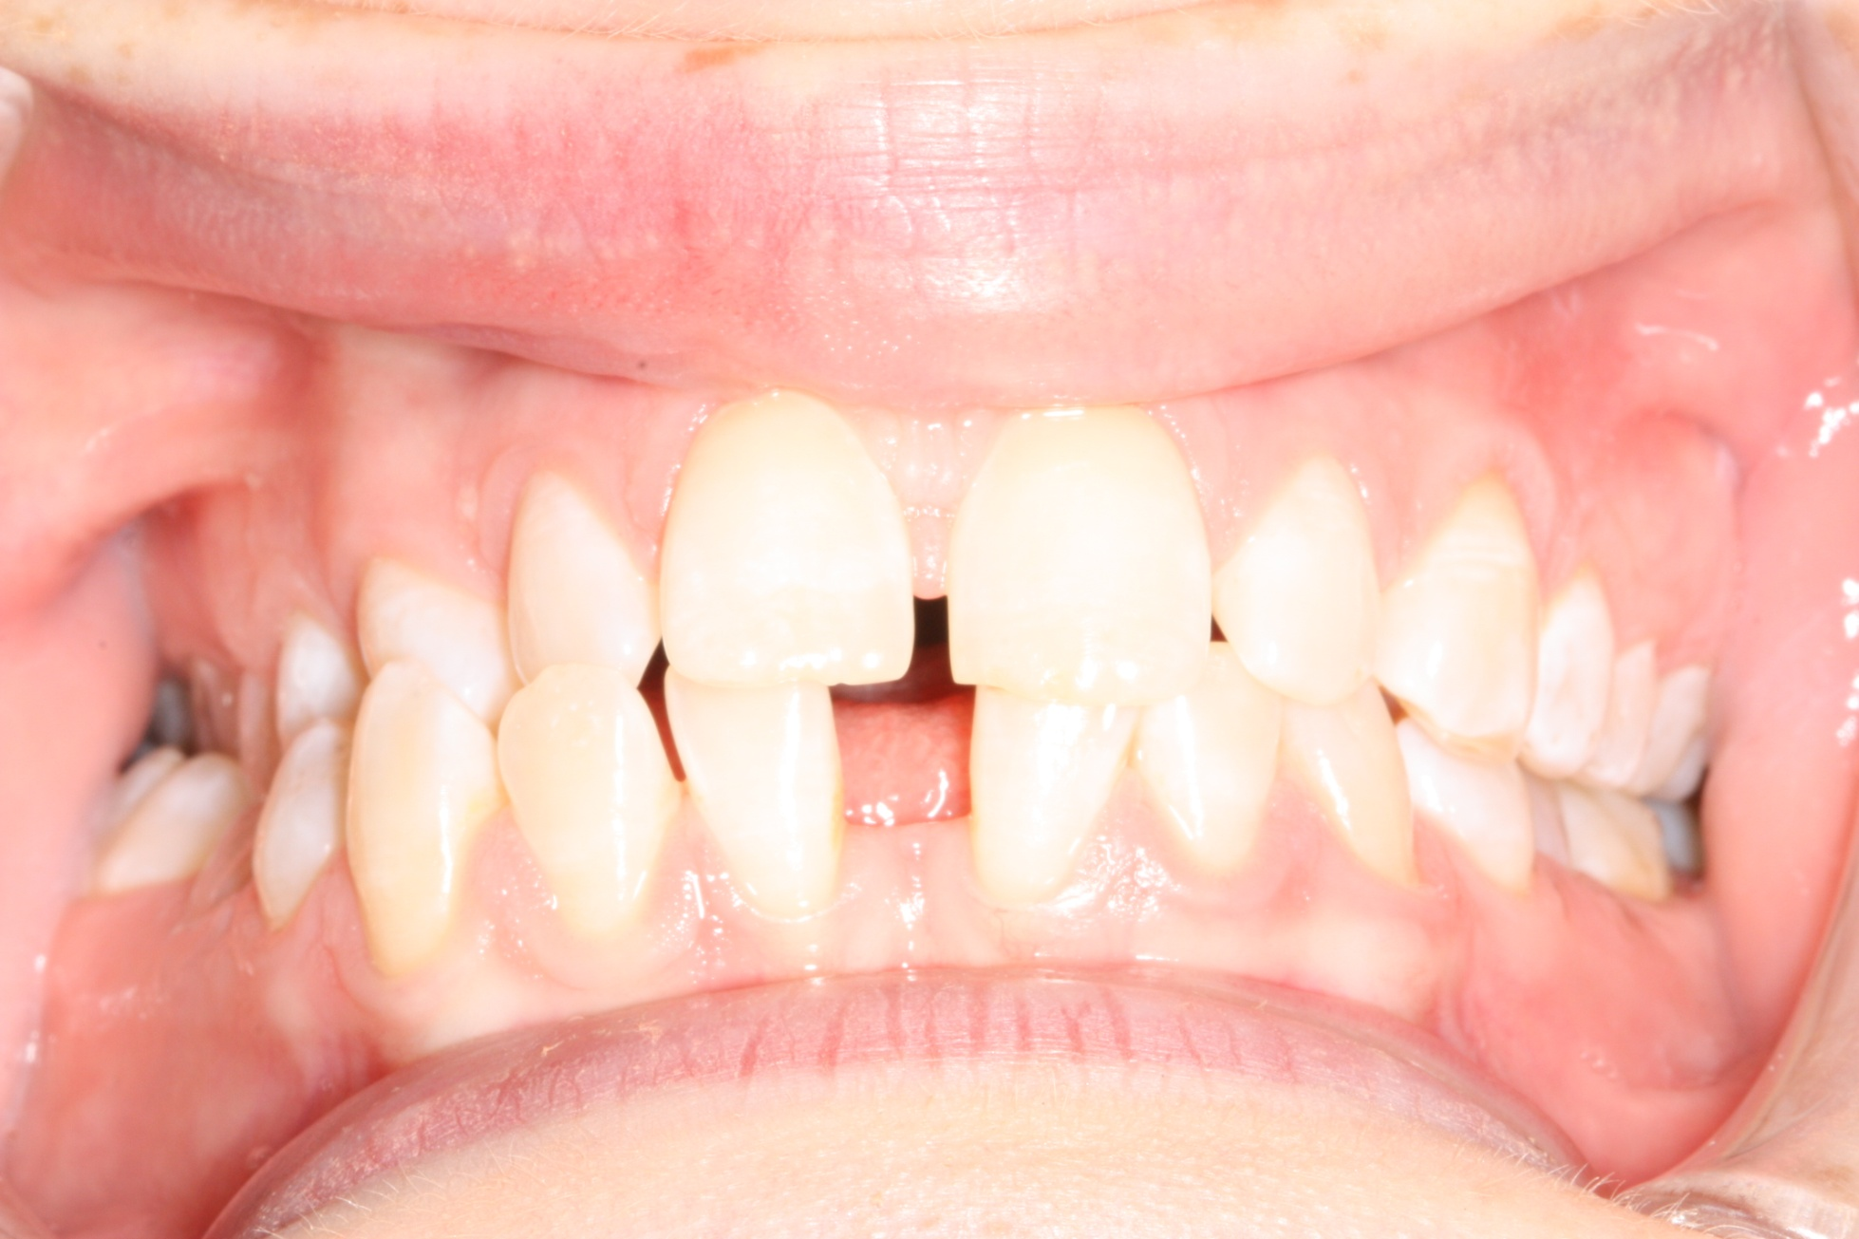
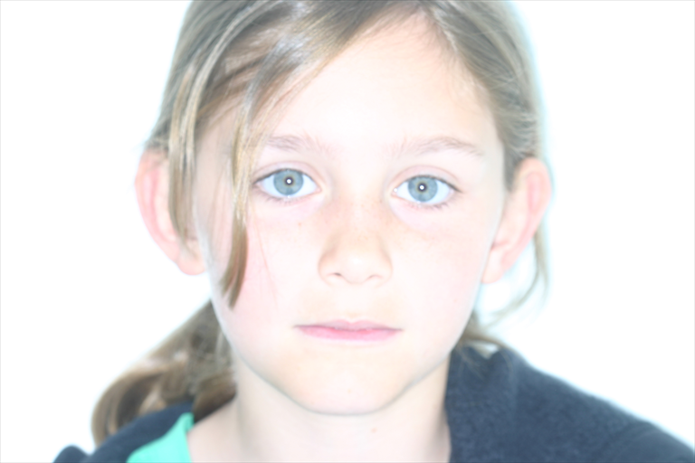
Indications for Clinical photographs
TREATMENT PLANNING

Slide 3
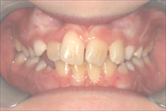
During treatment
Good for Monitoring Treatment and Training therapists/Lecturing

Slide 4
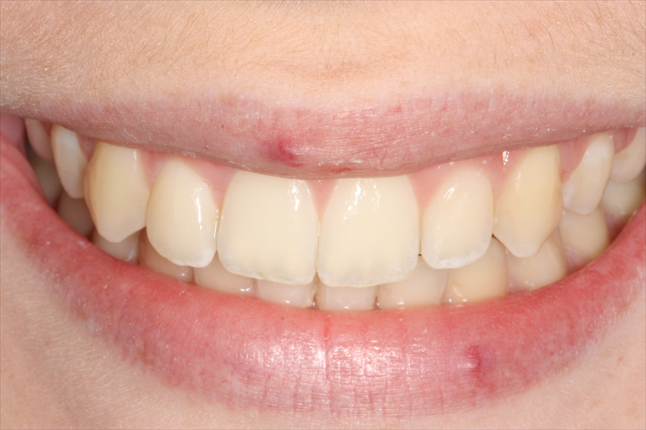
Post treatment
For Before and After photos and to monitor the retention phase

Slide 5
Other Indications
Recording anomalies of tooth colour eg fluorosis, hypoplasia or discolouration
Recording gingival condition eg inflammation or recession.

Slide 6
Standard Views
Extra-Oral- Frontal view with lips at rest and smiling /Lateral view in the Natural head position with lips at rest
Intra-Oral- Anterior view, Right and left buccal views(all in occlusion) and occlusal views of upper and lower

Slide 7
Extraorals

Slide 8
Extra-orals

Slide 9
Extra-orals

Slide 10
Intra-Orals

Slide 11
Intra-Orals

Slide 12
Intra-Orals

Slide 13
Intra-Orals

Slide 14
Intra-Orals

Slide 15
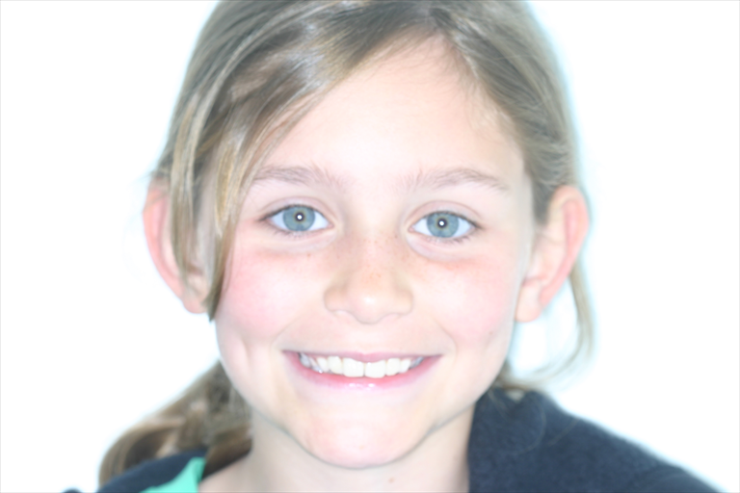
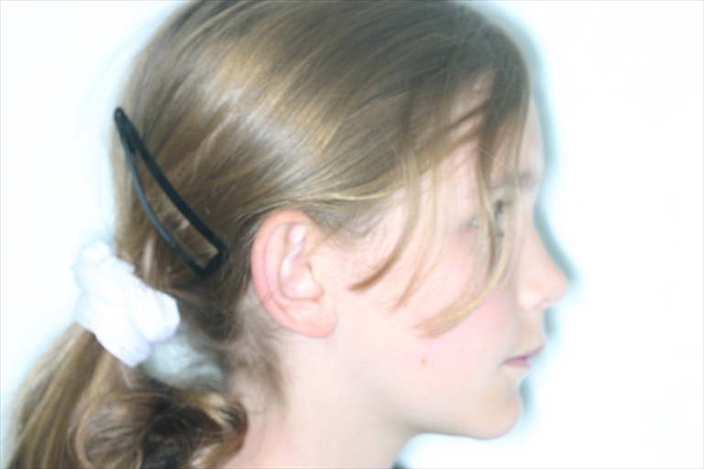
EXTRA- ORAL VIEWS
PATIENT SHOULD BE STANDING AGAINST A PLAIN BACKGROUND
IN NATURAL HEAD POSITION, USUALLY FRANKFORT PLANE PARALLEL
TO FLOOR
HEAD & FACE SHOULD FILL FRAME
SMILE SHOULD BE NATURAL & NOT FORCED: REACH THE EYES
EAR SHOULD BE SEEN IN LATERAL POSITION & FRANKFORT PLANE
AGAIN PARALLEL TO FLOOR

Slide 16
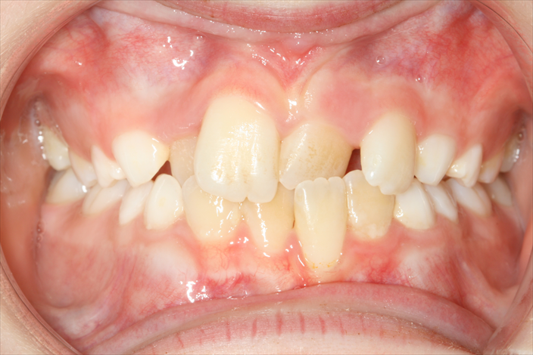
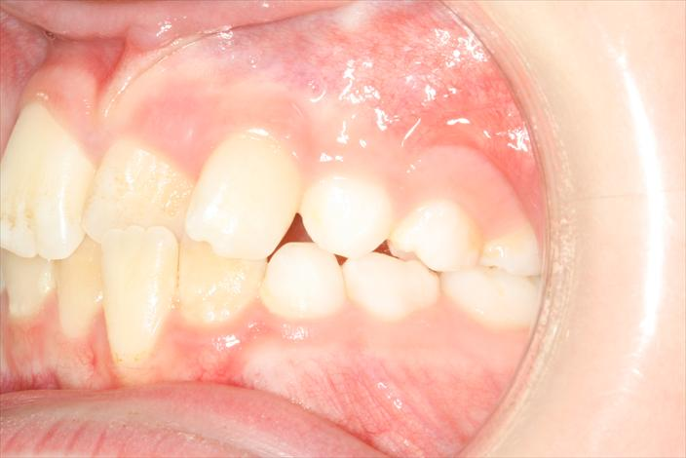
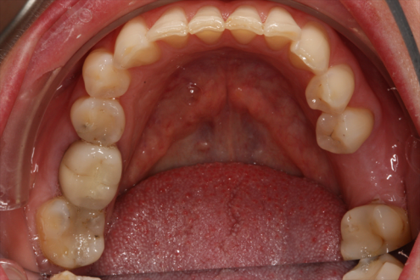
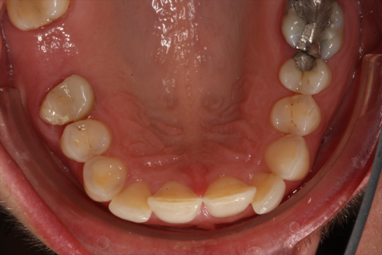
INTRA- ORAL VIEWS
USE TRIANGULAR PHOTO CHEEK RETRACTORS
PATIENT IN OCCLUSION
HOLD RETRACTORS FOR GOOD VISIBILITY OF FIRST MOLAR
TAKE BUCCAL VIEW WITH PARALLEL OCCLUSAL PLANE & CAMERA
POSITIONED AT FIRST PREMOLAR AREA
HOLD LIP RETRACTOR DOWNWARDS & OUT
WARM MIRROR TO PREVENT STEAMING FROM BREATH
TRY FOR LOWER OCCLUSAL FOR TONGUE TO GO BEHIND MIRROR

Slide 17
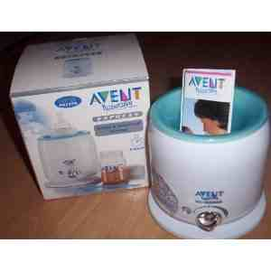
MATERIALS TO USE

Slide 18
CHEEK RETRACTORS
TRIANGULAR CHEEK RETRACTORS FOR EASY VIEW OF FIRST MOLARS
DAMPEN FOR PATIENT COMFORT
OFFER VASELINE IF DRY LIPS
PATIENT IN MOLAR OCCLUSION
AIM CAMERA AT FIRST PREMOLAR REGION

Slide 19
LIP RETRACTOR
Used to take occlusal shots
Hold downwards and forwards
Can ask patient to hold the end
Dampen before palcing for patient comfort

Slide 20
PHOTOGRAPHIC MIRROR
Use mirrors with handles to avoid fingers being seen in photos
Medium size mirror is correct for the majority of cases
To prevent misting place the mirror in a plastic lab bag and then in a bottle warmer
Give clear confident instructions to patient to reassure them

Slide 21
DOWNLOADING
Download to your practice management software via card reader as per the program’s settings

Slide 22
Summary
Gold Standard is to take clinical photographs for every patient pre- and post-treatment.
These are useful for recording occlusion, any abnormalities of the enamel, restorations in teeth and gingival heights/abnormalities.
Also useful for monitoring treatment progress and motivating patient’s during treatment.

